Slide 1
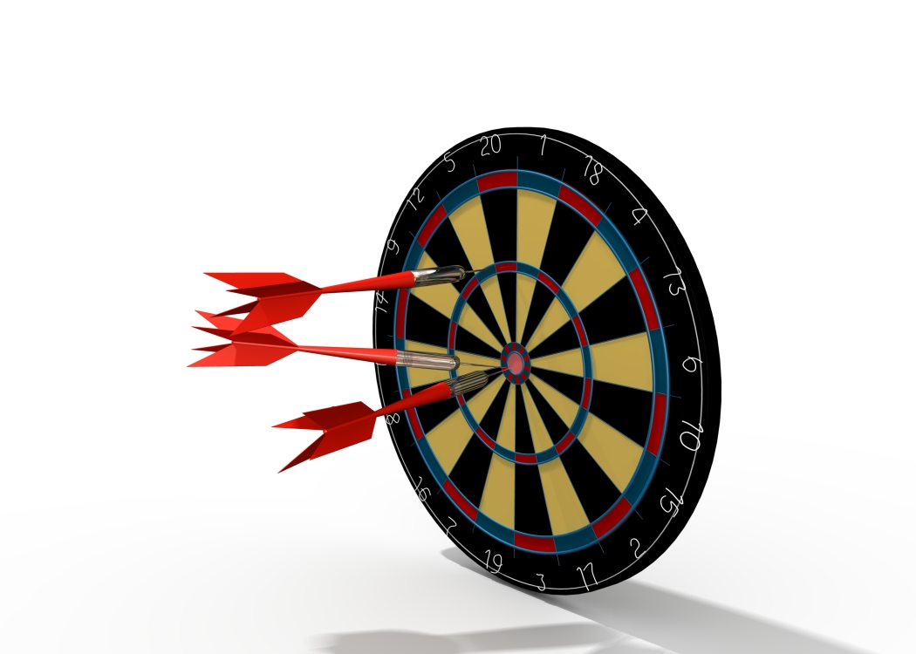
Targets

Slide 2
Todd has 3 darts. He scored a total of 10 points. If all 3 darts hit the target, how many possible ways could he have scored these points?
1
He could hit 5, 4, 1
He could hit 5, 3, 2
He could hit 4, 4, 2
He could hit 4, 3, 3
Answer: 4 Ways
2
3
4
5
4
3
2
1

Slide 3
Macey shot her 3 arrows in archery class. If each arrow hit the target for a total score of 10, what targets could she have hit?
She could hit 6, 2, 2
She could hit 4, 4, 2
She could hit 4, 3, 3
6
2
3
4
10
4
3
2

Slide 4
Alice had 4 arrows in archery class . Each arrow hit the target. Her total score was 20. How many ways could she have earned this score?
6
5
4
3
3
2
3
4
Alice could hit 6, 6, 6, 2
Alice could hit 6, 6, 4, 4
Alice could hit 6, 6, 5, 3
Alice could hit 6, 4, 5, 5
Alice could hit 5, 5, 5, 5
Answer 5 ways
5
6

Slide 5
Will has 3 bullets in his gun. He shoots the 3 bullets and every bullet hits the target. His score is 20. How many ways could he have scored this total?
He could hit 10, 6, 4
He could hit 10, 8, 2
He could hit 8, 8, 4
He could hit 8, 6, 6
Answer: 4 Ways
10
2
4
6
8
10
8
6
4
2

Slide 6
If Catherine throws three darts at the target. Assuming all darts hit the board, how many different point totals could she score?
2
5
7
He could hit 7, 7, 7
He could hit 7, 7, 5
He could hit 7, 7, 2
He could hit 7, 5, 5
He could hit 7, 5, 2
He could hit 7, 2, 2
He could hit 5, 5, 5
He could hit 5, 5, 2
He could hit 5, 2, 2
He could hit 2, 2, 2
Answer: 4 Ways
Answer: 10

Slide 7
If Blake throws three darts at the target. Assuming all darts hit the board, how many different point totals could he score?
2
4
6
He could hit 6, 6, 6=18
He could hit 6, 6, 4=16
He could hit 6, 6, 2=14
He could hit 6, 4, 4=14
He could hit 6, 4, 2=12
He could hit 6, 2, 2=10
He could hit 4, 4, 4=12
He could hit 4, 4, 2=10
He could hit 4, 2, 2=8
He could hit 2, 2, 2=6
Answer: 7

